Slide 1
AeroCombat documentation
Author: Ben Names

Slide 2
1.0 – introduction
AeroComBAT [Aeroelastic Composite Beam Analysis Tool] is an analysis tool intended to facilitate aeroelastic analysis for composite beams. Due to a series of substantial updates, much of the code's original capabilities have been omitted from its current incarnation. At present, AeroComBAT’s capabilities are relegated to cross-sectional analysis.
What follows is a detailed description of the currently supported capabilities, as well as a high-level theoretical description of those capabilities. Slides describing theory have a Theory box, where as application slides have an “Application” box in the top left corner of the slide.
It should be emphasized that while AeroComBAT has been extensively verified at different stages, it is still very much in the BETA stages of development, and users should always be on the lookout for errors.

Slide 3
1.1 – installation
In order to utilize AeroComBAT, first install the latest version of the Anaconda python distribution (https://www.anaconda.com/). The base python installation also works, but by installing the Anaconda you also get the following dependencies automatically installed:
Numpy
Scipy
Next, install the following dependencies by launching the Anaconda CMD prompt using the pip command:
“pip install pyOpengl”
“pip install pyqtgraph”
Finally, it is recommended that pyNastran also be installed, as it will facilitate importing models from NASTRAN and exporting AeroComBAT models to NASTRAN decks
“pip install pyNastran”
To run AeroComBAT, either run the AeroComBAT.py script within an IDE (such as SPYDER), or run it from the Command Prompt by navigating to the directory that houses the AeroComBAT main runfile:
“python AeroComBAT.py”
Note that sometimes because of permissions, Anaconda installs a separate “Anaconda Prompt” to not overwrite an existing python installation.

Slide 4
2.1.0 – Cross-sectional analysis
The aim of cross-sectional analysis, is to decompose a structures’ behavior into two pieces, a global behavior, and a local behavior
If a structure can be characterized such that its global behavior is essentially 1 dimensional (such as a fuselage, wing under lift, etc.), then the overall degrees of freedom required to characterize a structure can be reduced, resulting in a reduced order model
This reduction in dimensionality is similar in concept to a Craig Bampton model, though the execution is completely unrelated
A simple and common workflow for cross-sectional analysis example might be the following:
To size a wing spar:
Mesh the cross-section of a wing spar
Analyze the section to get its equivalent beam stiffnesses (EI, EA, GJ, Gak)
Create beam elements using these stiffnesses
Run a global analysis in order to generate global loads
Apply global loads to the local cross-sectional models to achieve cross-sectional stresses and strains

Slide 5
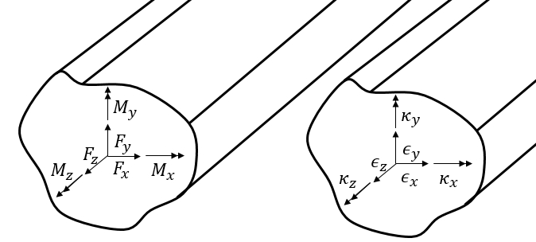
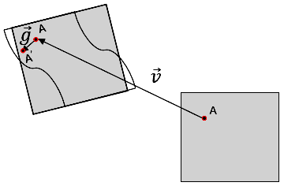
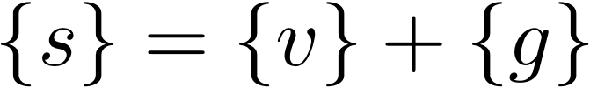
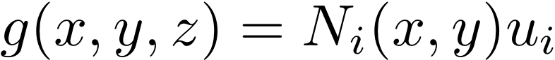
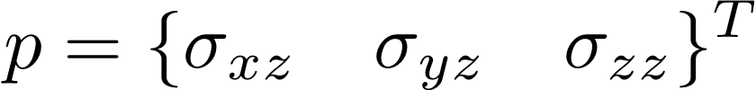
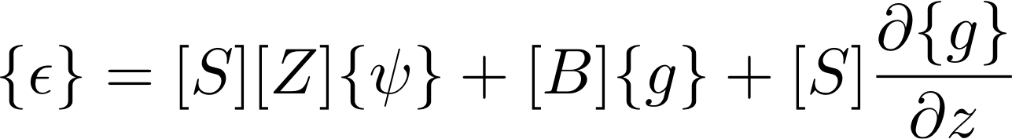
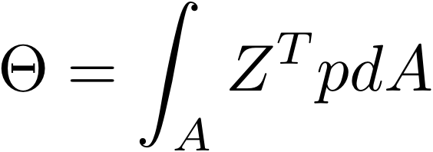
2.1.1 – local VS global behavior
Theory
local
global
We start with an assertion that the local translation of a point within beam cross-section, is a superposition of the global section displacements (think beam global translations/rotations) and the local displacement due to cross-sectional warping
By writing the displacements in this way, we can then express the strain within a cross-section in the following way:
The global behavior is the behavior we typically associate with beam analysis, such as the global beam displacements and rotations, the beam internal loads (axial, shear, bending moments, etc.)
In fact, beam internal loads can be characterized as an integral of the applied tractions:
y
x
z
Rigid Body Section Strain
Strain due to warping
Strain due to a difference in warping

Slide 6
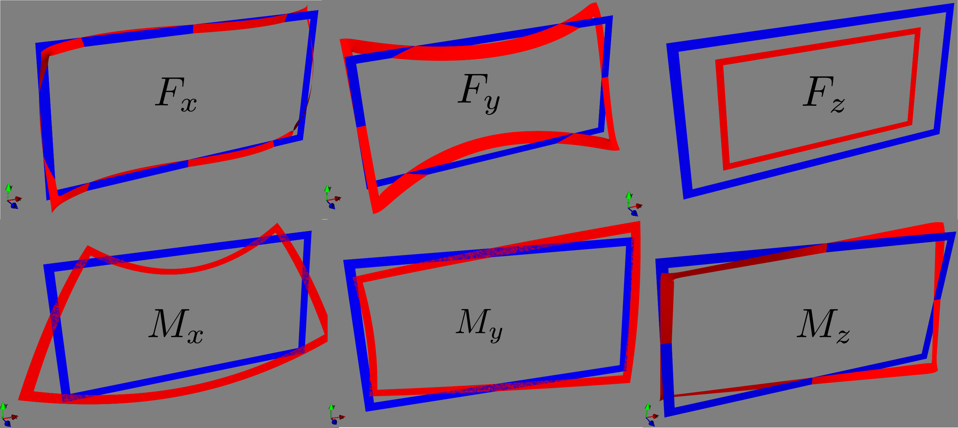
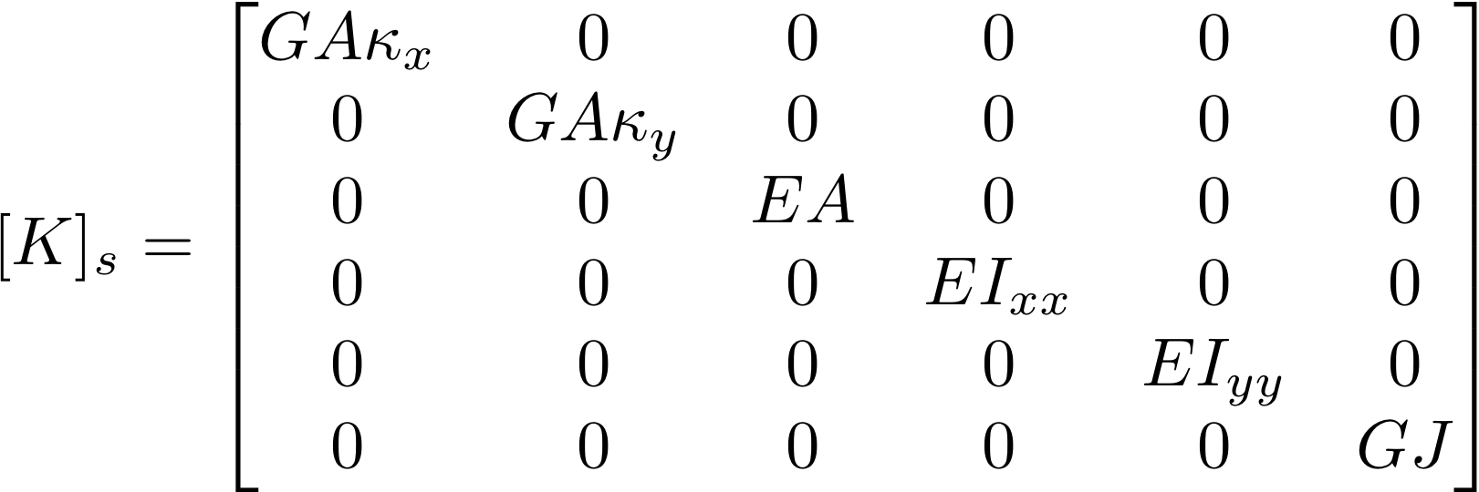
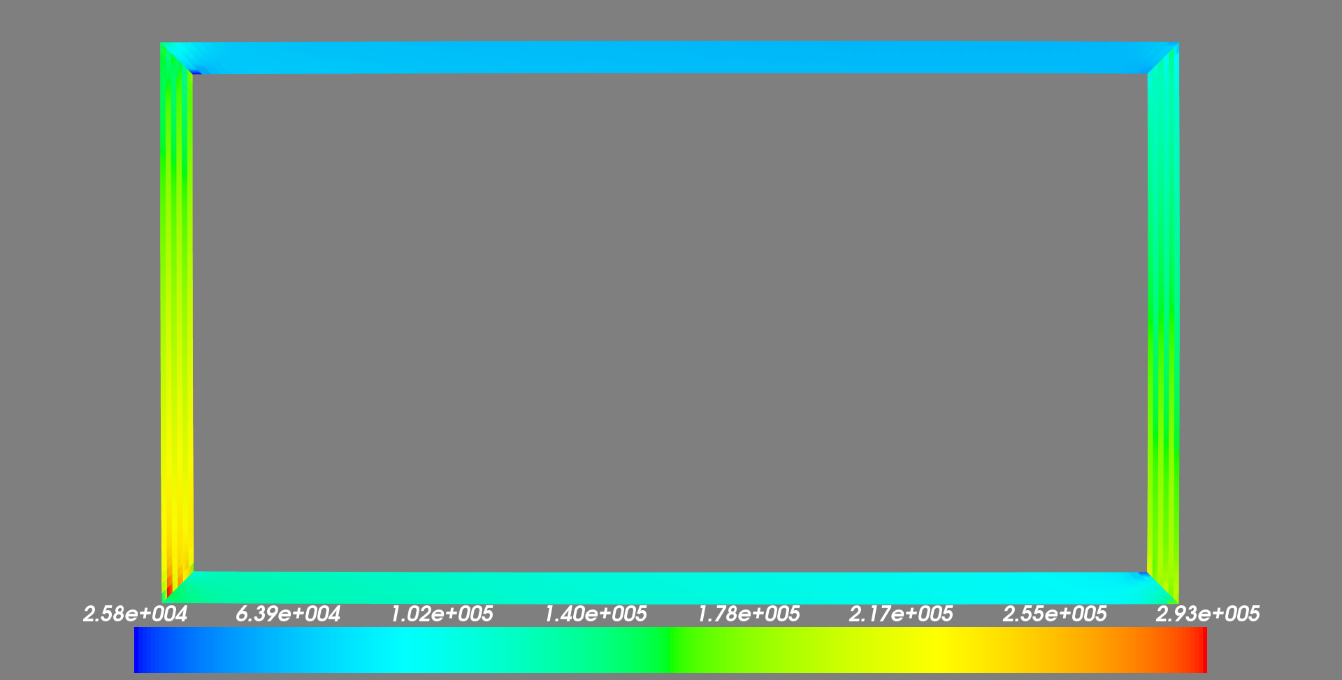
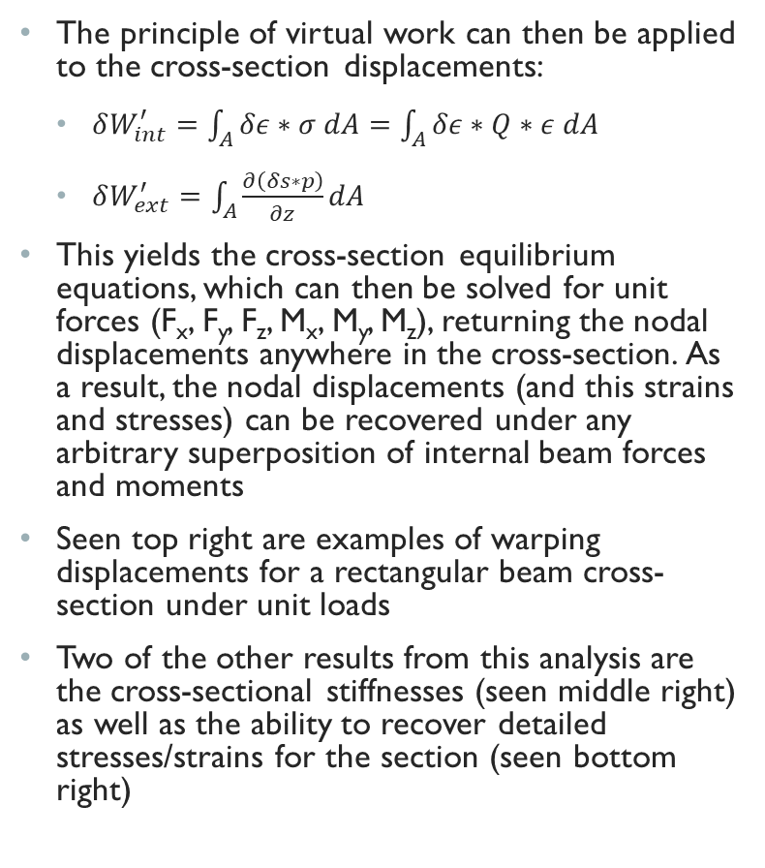
2.1.2 – Cross-Section Equilibrium Equations
Theory
The principle of virtual work can then be applied to the cross-section displacements:
$δW_{int}^{′}=\int_{A}{δε∗σ dA=\int_{A}{δε∗Q∗ε dA}}$
$δW_{ext}^{′}=\int_{A}{\frac{∂\left(δs∗p\right)}{∂z}dA}$
This yields the cross-section equilibrium equations, which can then be solved for unit forces (F_{x}, F_{y}, F_{z}, M_{x}, M_{y}, M_{z}), returning the nodal displacements anywhere in the cross-section. As a result, the nodal displacements (and this strains and stresses) can be recovered under any arbitrary superposition of internal beam forces and moments
Seen top right are examples of warping displacements for a rectangular beam cross-section under unit loads
Two of the other results from this analysis are the cross-sectional stiffnesses (seen middle right) as well as the ability to recover detailed stresses/strains for the section (seen bottom right)
Cross-section stiffness matrix
*This stiffness matrix is for a simple cross-section only
3D Stress/Strain Recovery

Slide 7
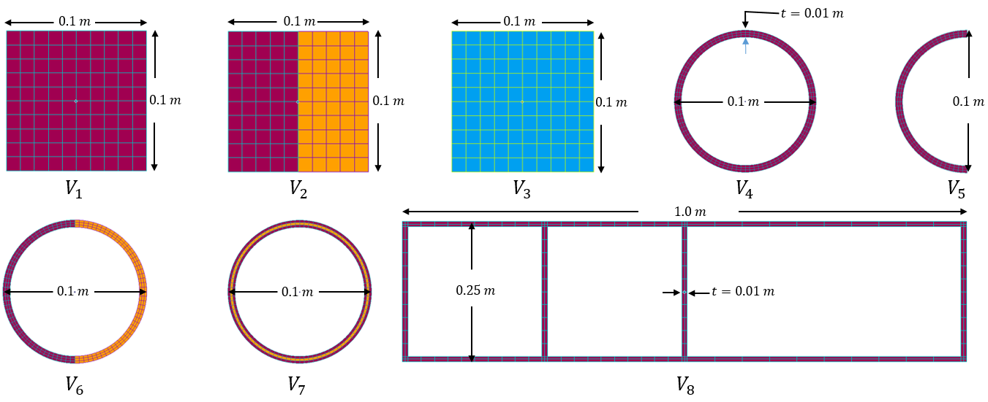
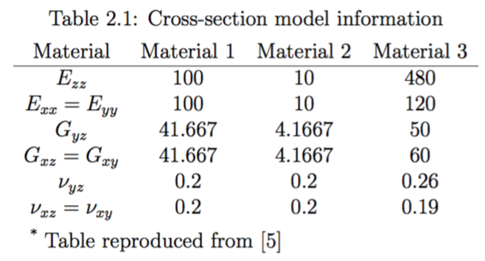
2.2.0 – Cross-Sectional Stiffness Verification
Verification
Seen right are one group of cross-section which was used to verify AeroComBAT against a similarly formulated tool, BECAS
Note:
Maroon: Material 1
Orange: Material 2
Blue: Material 3

Slide 8
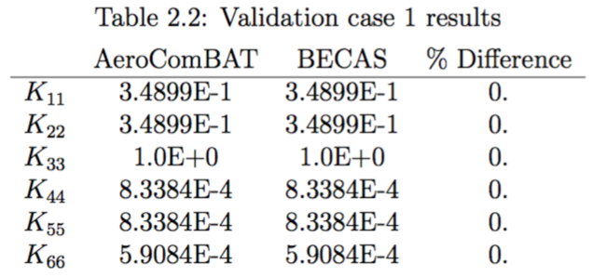
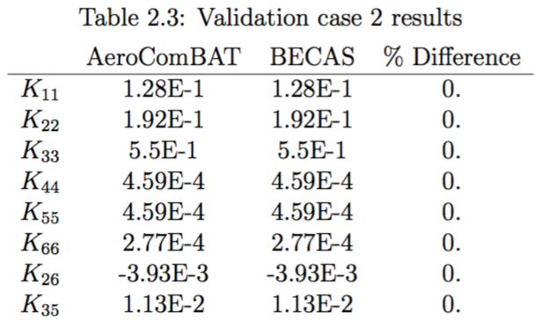
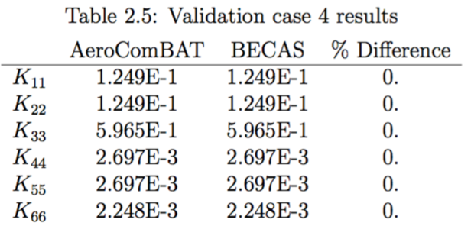
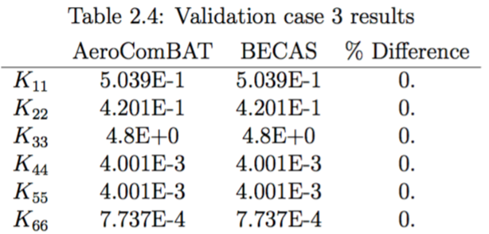
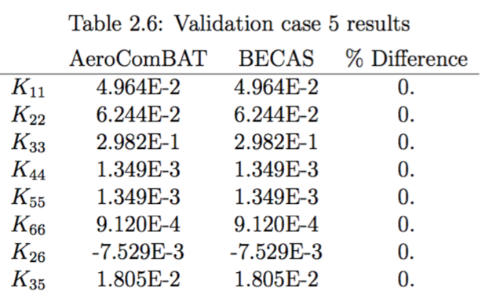
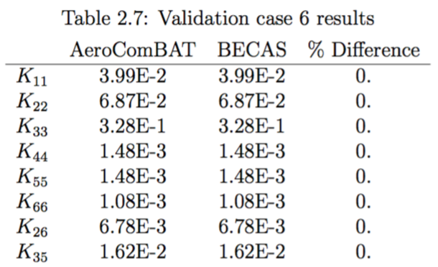
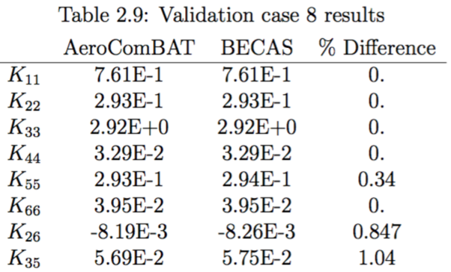
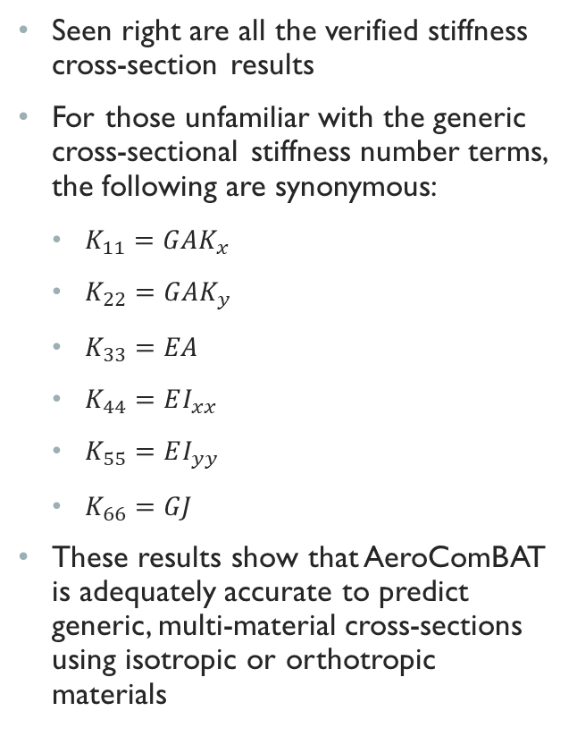
2.2.1 – Cross-Sectional Stiffness Verification
Verification
Seen right are all the verified stiffness cross-section results
For those unfamiliar with the generic cross-sectional stiffness number terms, the following are synonymous:
$K_{11}=GAK_{x}$
$K_{22}=GAK_{y}$
$K_{33}=EA$
$K_{44}=EI_{xx}$
$K_{55}=EI_{yy}$
$K_{66}=GJ$
These results show that AeroComBAT is adequately accurate to predict generic, multi-material cross-sections using isotropic or orthotropic materials

Slide 9
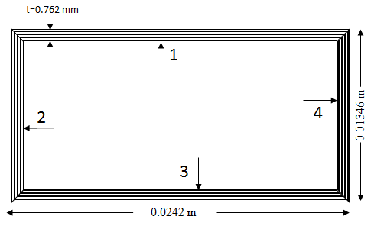
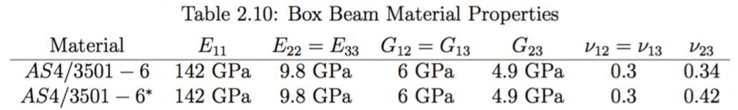
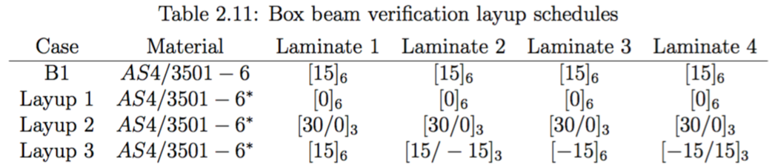
2.2.2 – Cross-Sectional Stiffness Verification
Verification
In addition to the cross-sections shows in Sec. 2.2.0, the following box beam was analyzed using the following laminates for the cross-section walls:

Slide 10
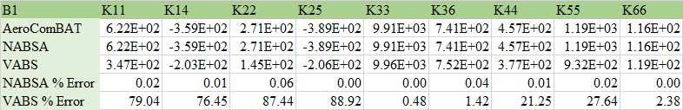
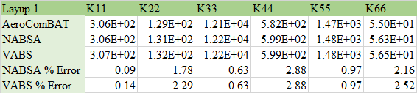
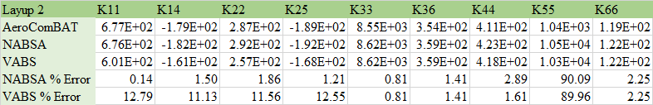
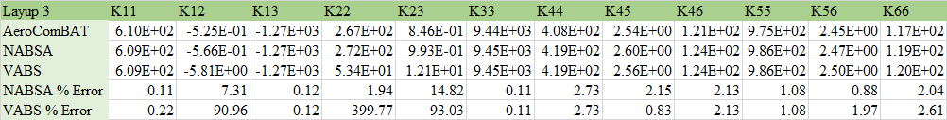
2.2.2 – Cross-Sectional Stiffness Verification
Verification
Seen right are the box beam stiffness terms compared against that of two codes, NABSA and VABS.
AeroComBAT and NABSA consistently show reasonable agreement, which makes sense since AeroComBAT, NABSA and BECAS all share the same formulation/approach
There are significant variances between AeroComBAT and VABS, especially WRT the transverse shear terms. While somewhat inexplicable, there is enough of a consistent agreement between BECAS and AeroComBAT to not be too concerned with the inaccuracy in these terms

Slide 11
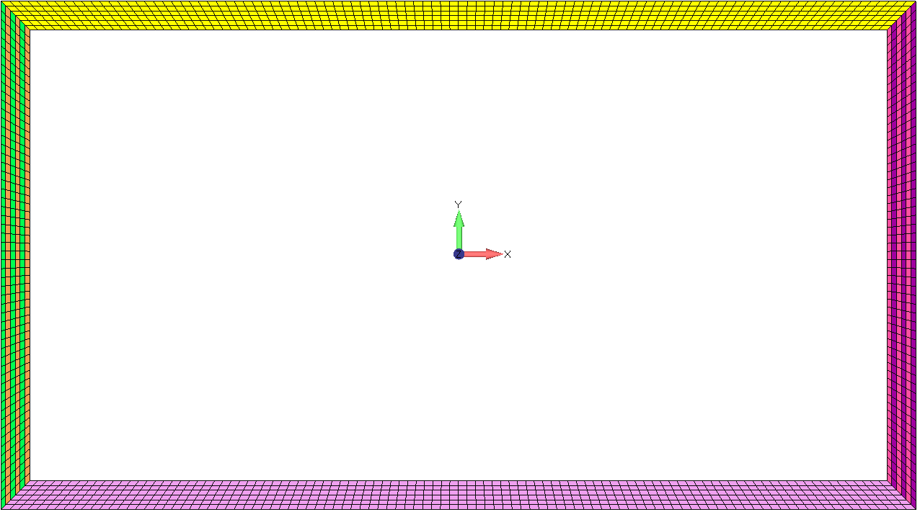
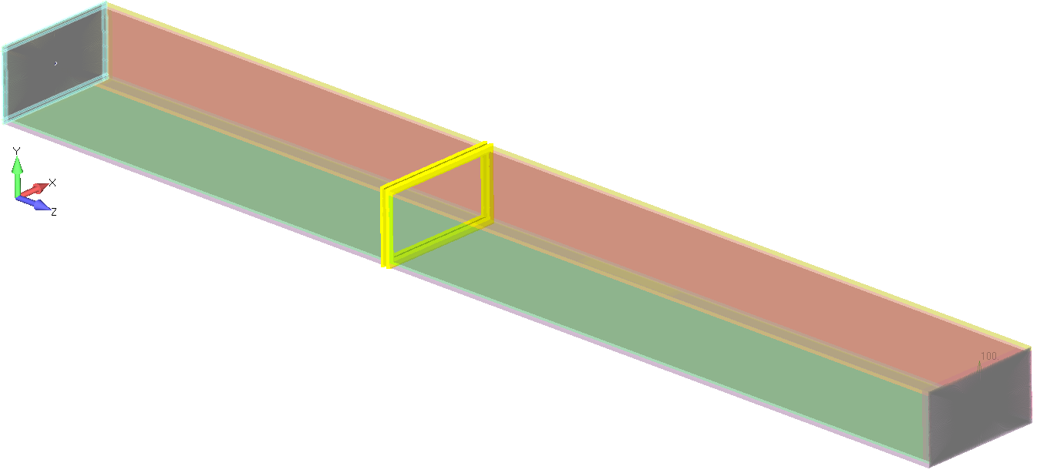
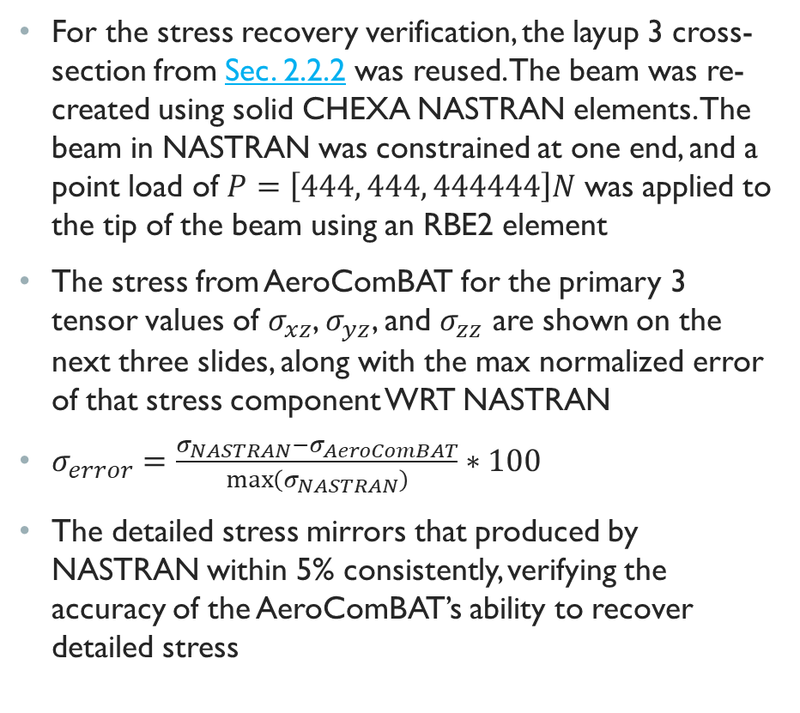
2.2.3 – Cross-Sectional Stiffness Verification
Verification
For the stress recovery verification, the layup 3 cross-section from Sec. 2.2.2 was reused. The beam was re-created using solid CHEXA NASTRAN elements. The beam in NASTRAN was constrained at one end, and a point load of $P=\left[444, 444, 444444\right]N$ was applied to the tip of the beam using an RBE2 element
The stress from AeroComBAT for the primary 3 tensor values of $σ_{xz}$, $σ_{yz}$, and $σ_{zz}$ are shown on the next three slides, along with the max normalized error of that stress component WRT NASTRAN
$σ_{error}=\frac{σ_{NASTRAN}−σ_{AeroComBAT}}{\max\left(σ_{NASTRAN}\right)}∗100$
The detailed stress mirrors that produced by NASTRAN within 5% consistently, verifying the accuracy of the AeroComBAT’s ability to recover detailed stress

Slide 12
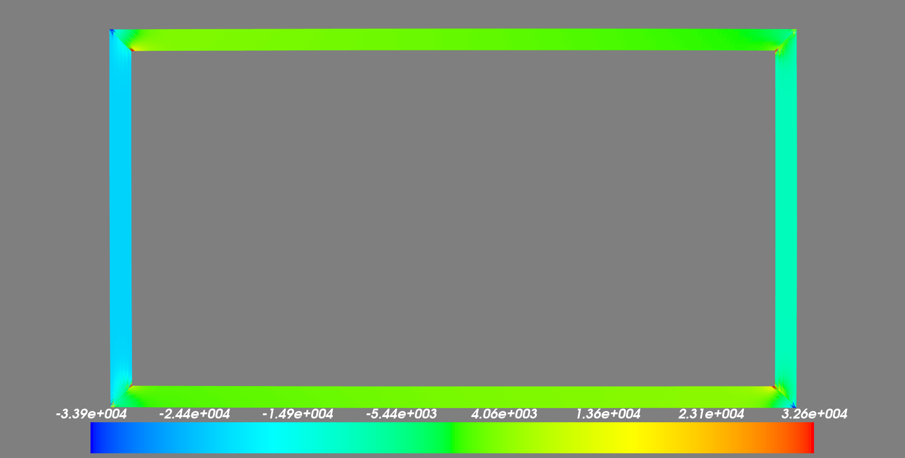
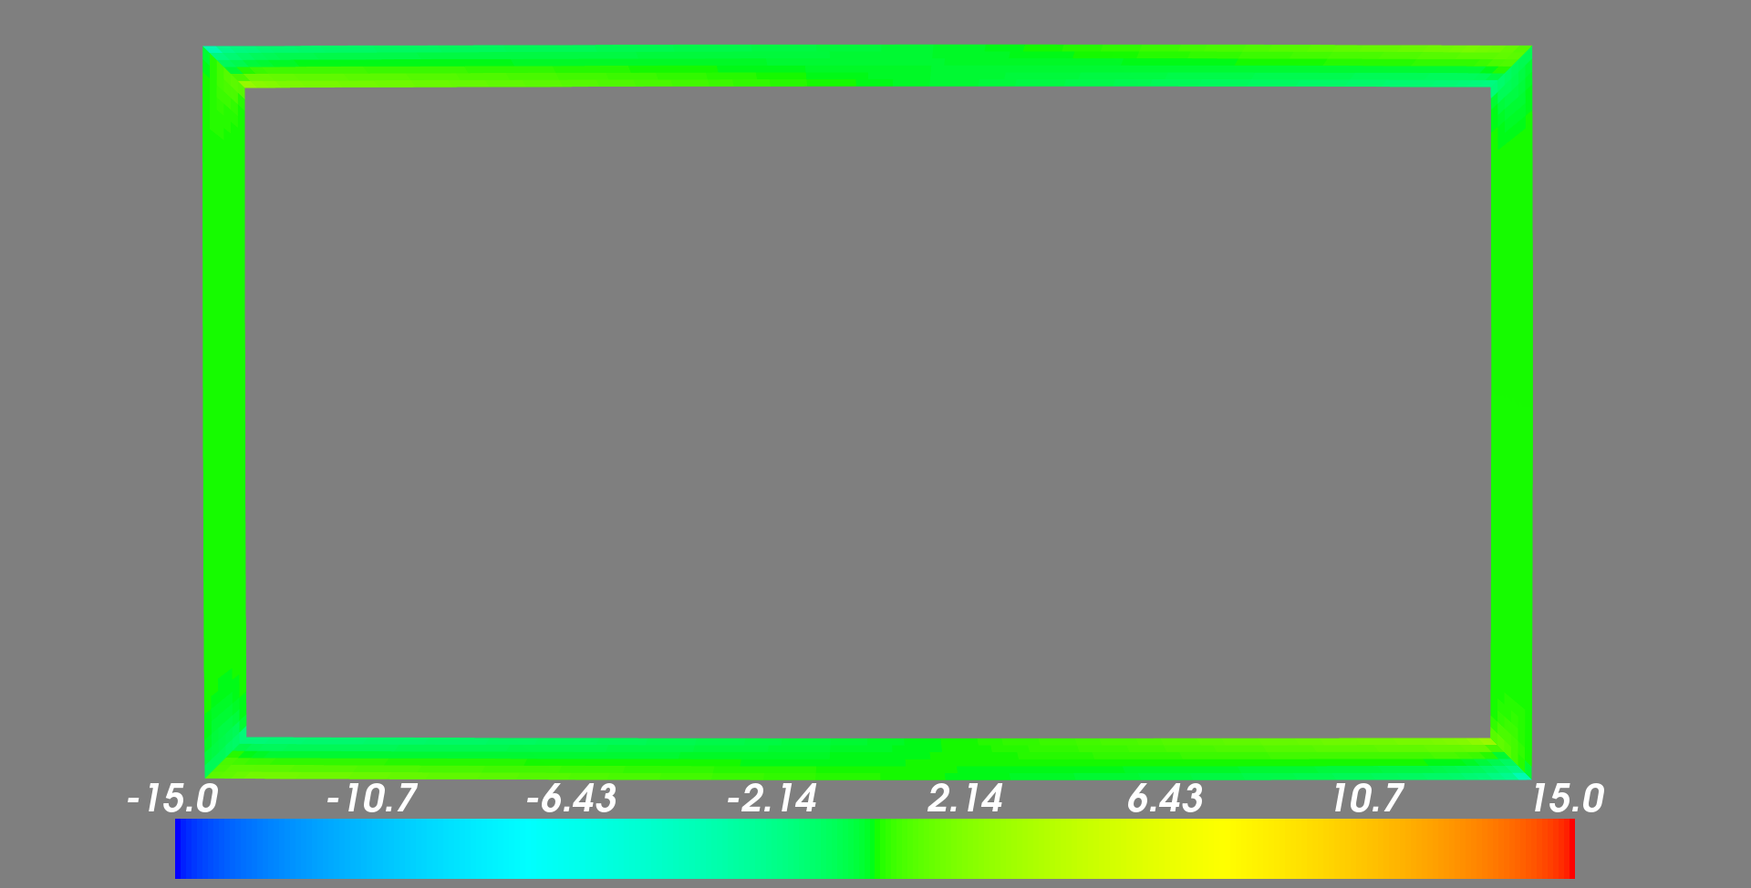
2.2.4 – Cross-Sectional Stiffness Verification
Verification
AeroCombat – $σ_{xz}$
Percent Error – $σ_{xz}$
Despite non-trivial peak stresses in the corners, all error WRT NASTRAN stress is within ~5%

Slide 13
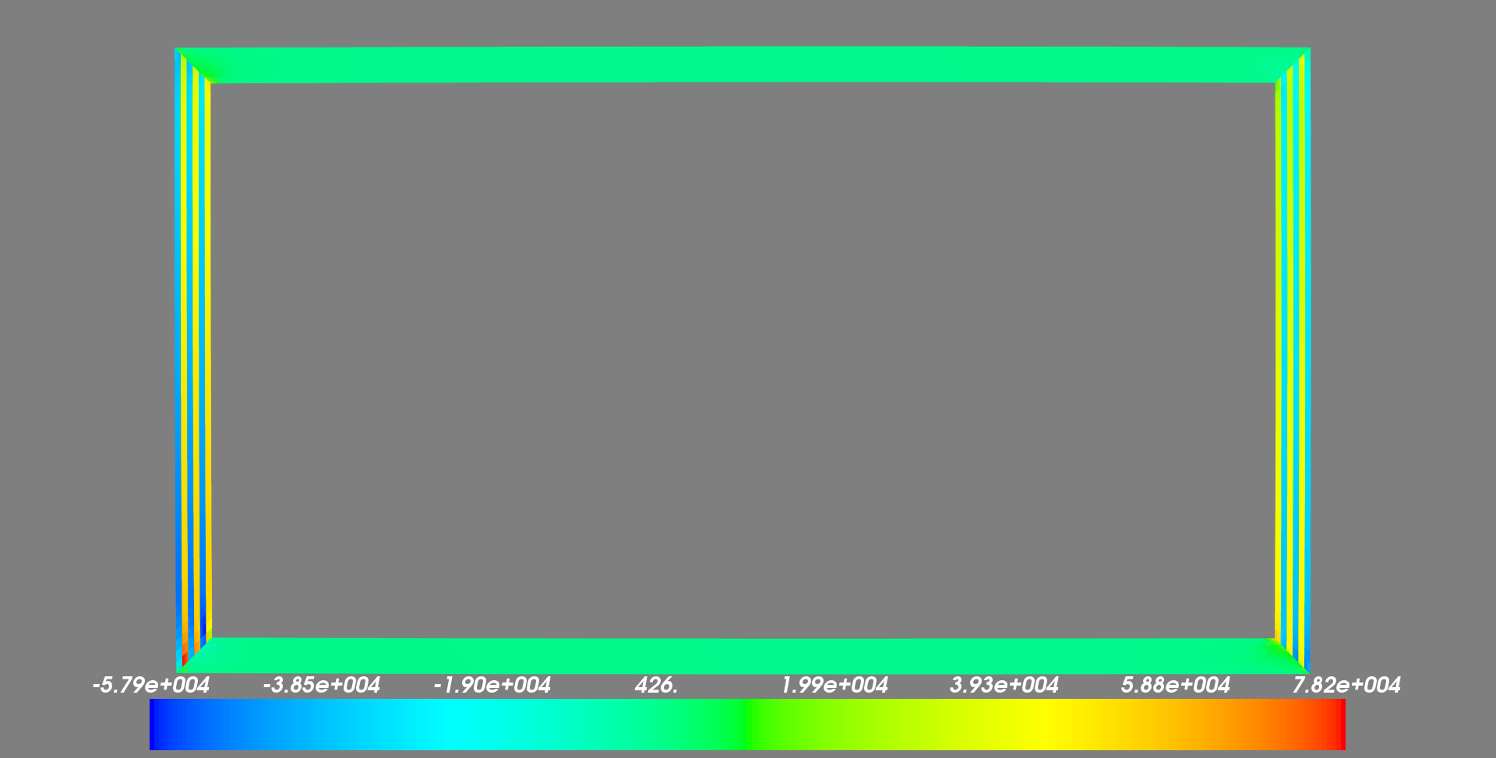
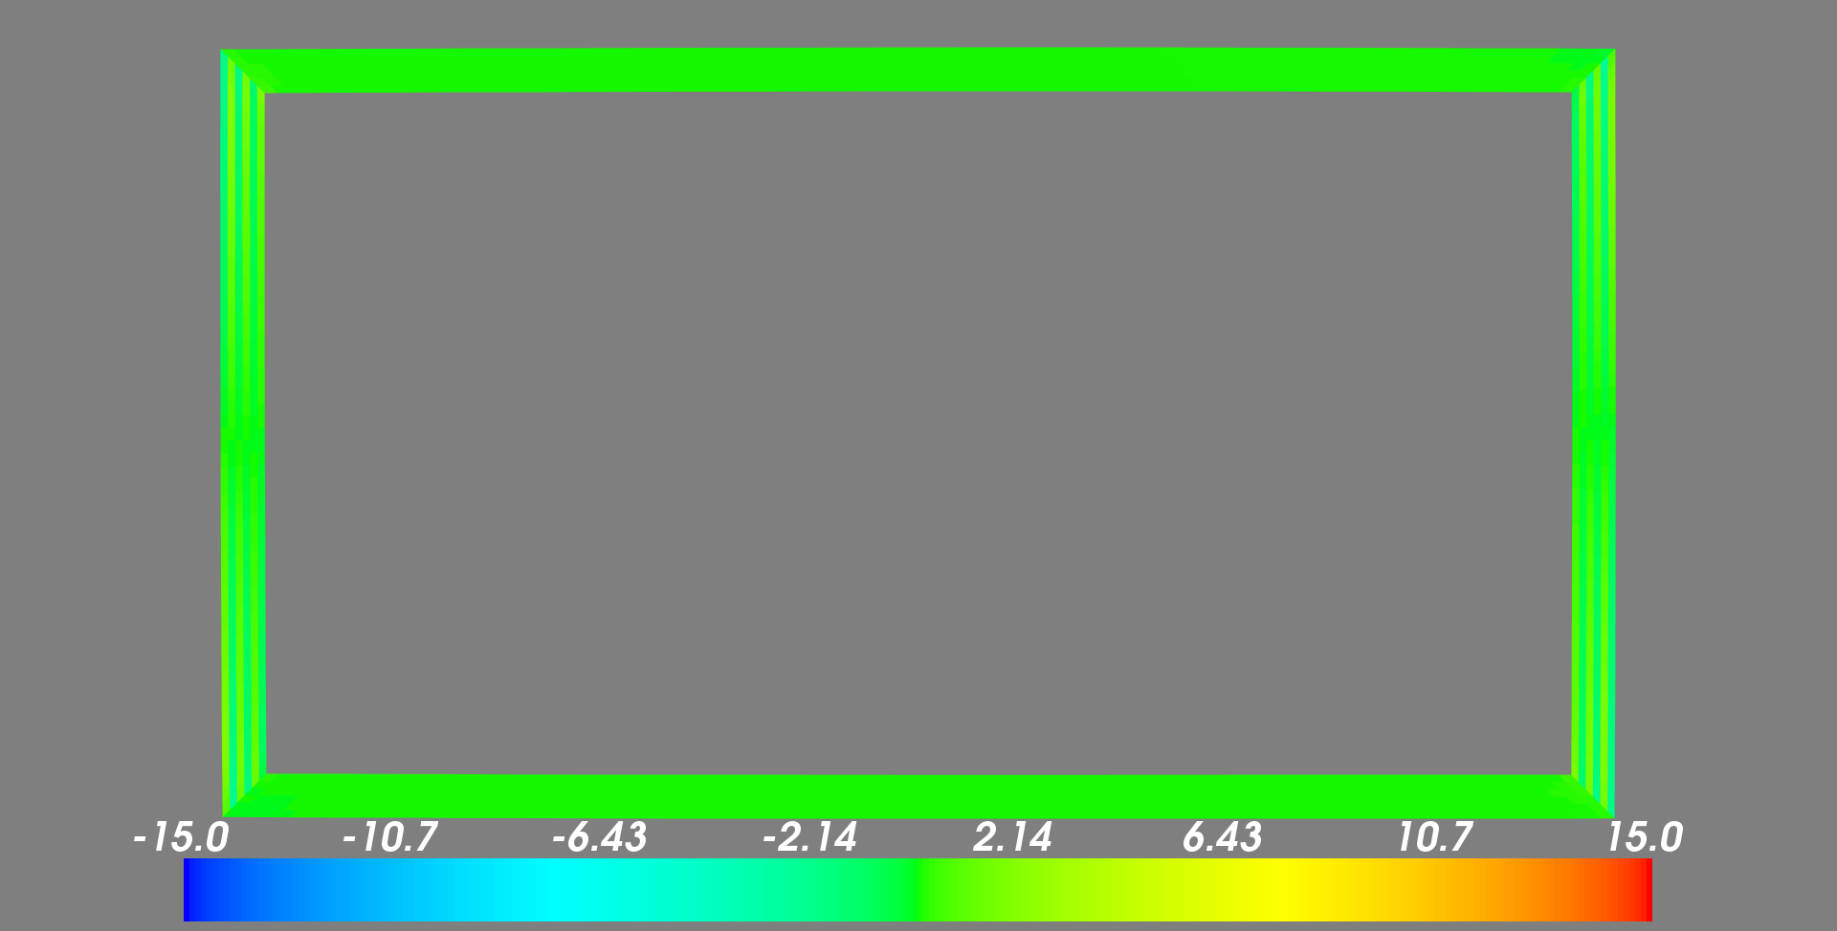
2.2.5 – Cross-Sectional Stiffness Verification
Verification
AeroCombat – $σ_{xz}$
Percent Error – $σ_{xz}$
Despite non-trivial peak stresses in the corners, all error WRT NASTRAN stress is within ~5%. Note that because of the laminate nature, stress discontinuities are very visible in the upstanding legs.

Slide 14

2.2.6 – Cross-Sectional Stiffness Verification
Verification
AeroCombat – $σ_{xz}$
Percent Error – $σ_{xz}$
Despite non-trivial peak stresses in the corners, all error WRT NASTRAN stress is within ~5%. Note that because of the laminate nature, stress discontinuities are very visible in the upstanding legs.

Slide 15
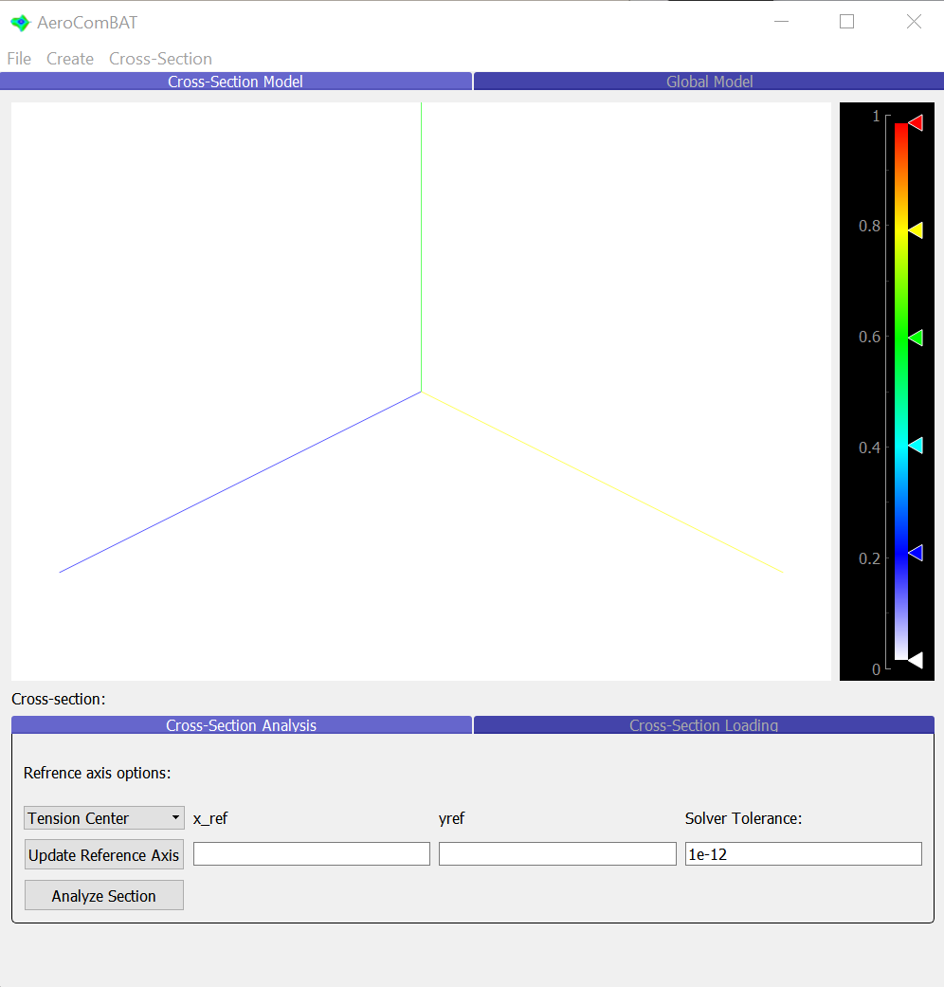
2.3.0 – AeroComBAT cross-sectional Analysis
Application
When running the AeroComBAT interface, you will be immediately placed into the cross-sectional analysis environment, seen right
Cross-sections can then be imported using the “File->Load AeroComBAT Input File” functionality. This will load a series of cards that will incrementally build up either a single cross-section, or a series of cross-sections. Once a cross-section has been successfully loaded into the tool, the “Cross-section” drop-down will be populated with a list of selectable cross-sections
As an example, AeroComBAT ships with a “Sample Inputs File” directory, and any one of these could be loaded as an example
Note: x-axis: blue; y-axis: yellow; z-axis: green
Note: Due to how the section analysis is conducted, all nodes must lie in the x-y plane
Note: Upon import, cross-sections are automatically translated to the “nodal” centroid of the section. To translate the section to a different location, you can use the “File->Translate Sections” command
If a cross-section has been translated, it must be analyzed before section properties or stress/strain can be queried

Slide 16
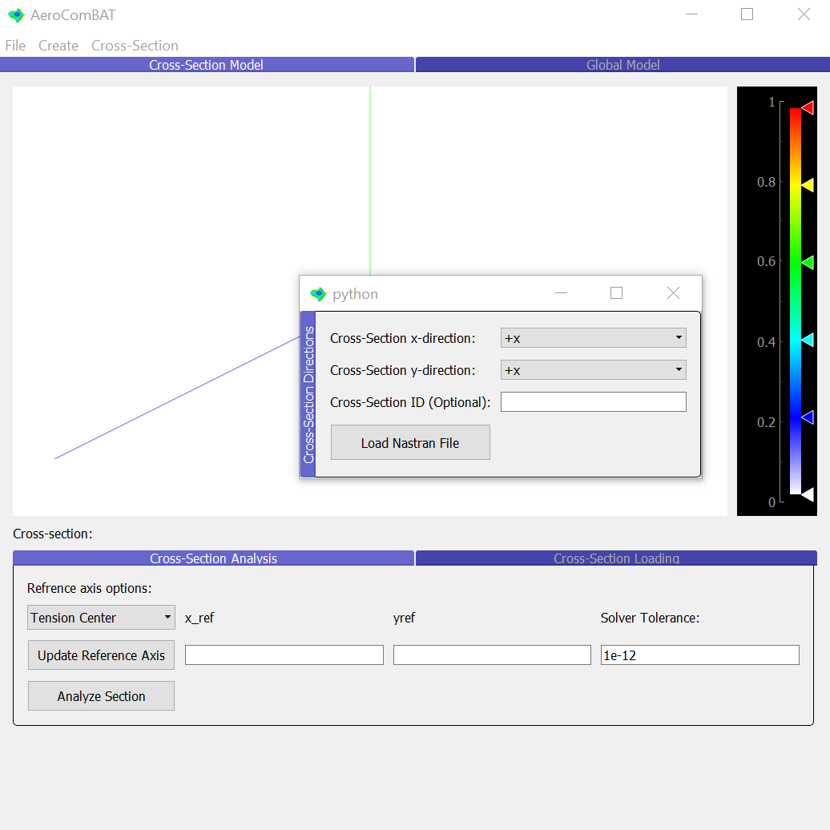
2.3.1 – AeroComBAT cross-sectional Analysis
Application
If the user has optionally installed pyNastran, the user will be able to import a simple NASTRAN run deck using the “File->Load NASTRAN Input File”
Once selecting the file of interest, a pop up will appear asking the user to specify how the NASTRAN mesh cross-section coordinates relate to the AeroComBAT cross-section coordinates
Note: When analyzing cross-sections, we are limited in that all elements (and thus nodes) must lie in the x-y plane. As such, if your NASTRAN cross-section mesh lies in a different plane, you’ll need to tell AeroComBAT what global CSYS your cross-section nodes relate to. For example, if a user’s mesh lies in the y-z plane, then +y global CSYS could correspond to the +x AeroComBAT CSYS, and the +z global CSYS would then correspond to the +y AeroComBAT CSYS. Possible entries include: “+x”, “-x”, “+y”, “-y”, “+z”, “-z”
When the user clicks “Load Nastran File”, AeroComBAT will read the NASTRAN deck using pyNastran and write out a corresponding AeroComBAT input file that then is automatically read
Note: For now, Nastran input files are limited to using only isotropic materials
Note: In this transcription, AeroComBAT will assume all elements and nodes within the NASTRAN dat file are all a part of the same cross-section, do not try to import multiple cross-section from one dat file
Note: The cross-section ID automatically associated with this Nastran dat file is the +1 larger than the largest existing cross-section ID. If no other cross-sections exist, that ID will be 1.

Slide 17
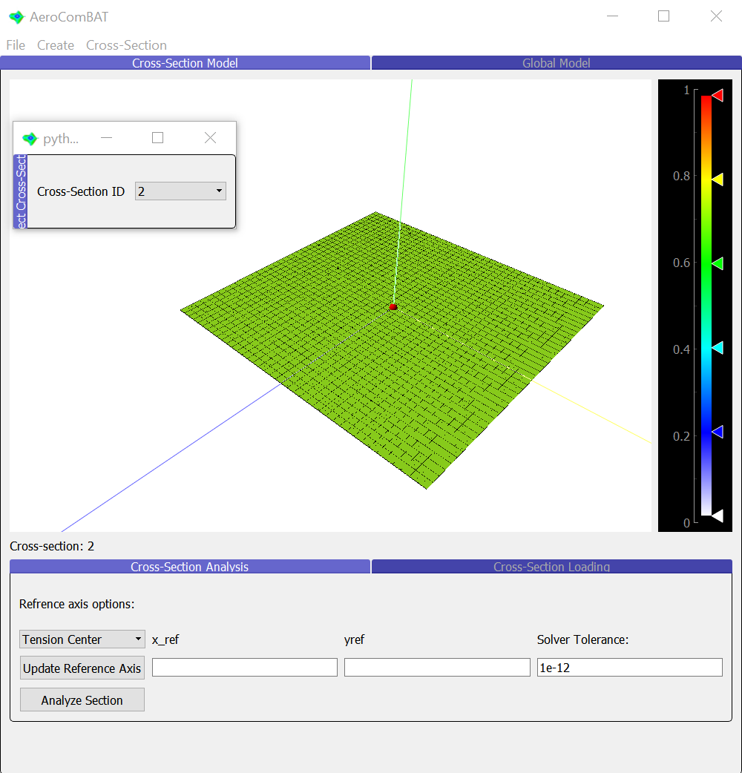
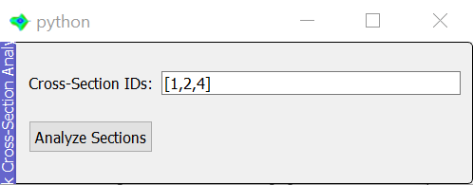
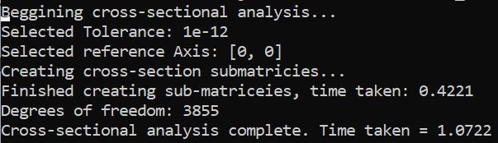
2.3.2 – AeroComBAT cross-sectional Analysis
Application
Having loaded in a cross-section, the successfully loaded cross-sections can be activated one at a time using the cross-section selection tool:
“Cross-Section->Select Section”
Once activated, the section can then be analyzed, which will then allow the user to determine the cross-sectional stiffnesses, as well as apply loads to the cross-section
Note: This process can often take a while, especially if cross-sections have many degrees of freedom.
Note: Because AeroComBAT uses the scipy MINRES iterative solver to solve the cross-section equilibrium equations, a residual tolerance is required. While simple cross-sections can be resolved using a larger tolerance, complex cross-sections often need residual tolerances as small as 1e-12 or less. It is recommended that for “new cross-sections,” a convergence study be conducted on at least one representative cross-section to determine an approximately adequate tolerance. This can be achieved by observing the convergence of the cross-sectional stiffness terms
If many different cross-sections need to be analyzed at once, the user can take advantage of the “File->Analyze Sections” command. Seen bottom right is an example of there 3 cross-sections were batched (1,2 and 4) using a 1e-12 tolerance, and at a cross-sectional

Slide 18
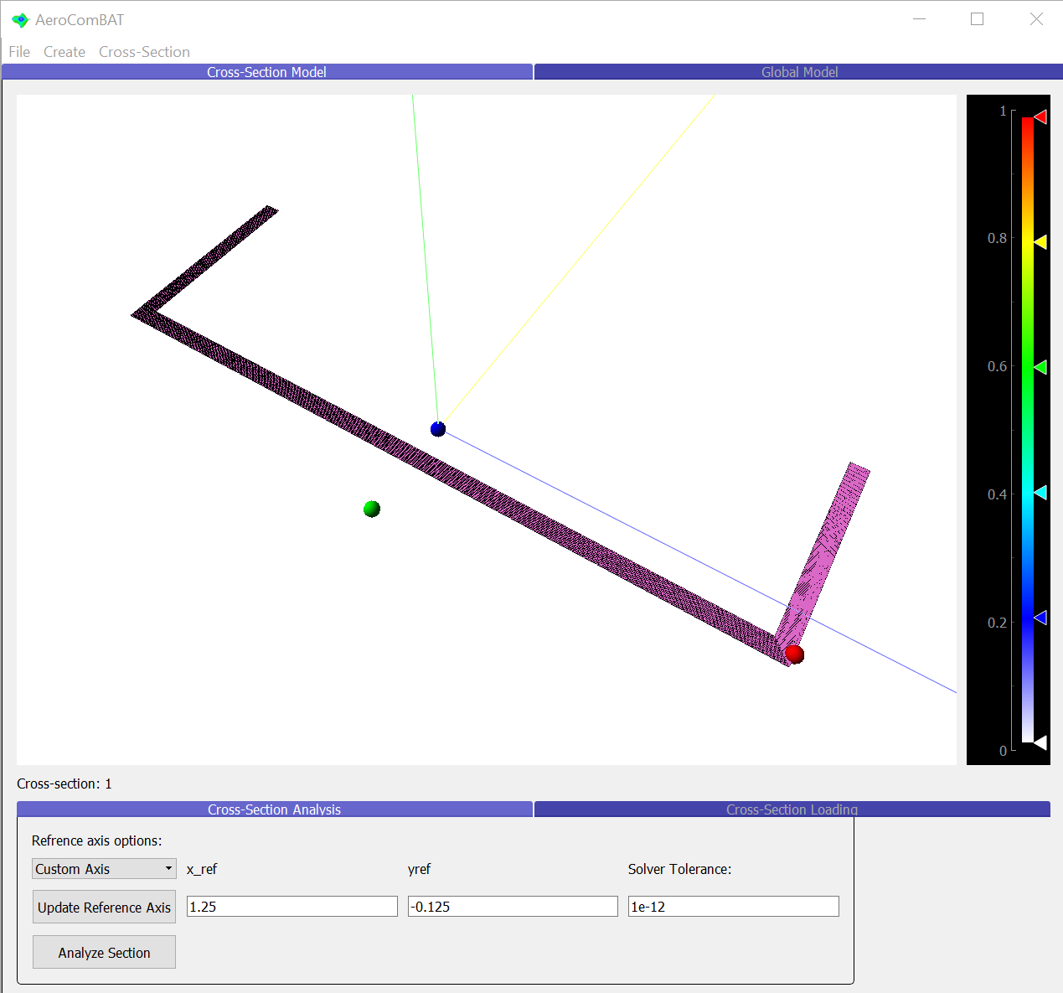
2.3.3 – AeroComBAT cross-sectional Analysis
Application
An important decision to make when making a beam model is to consider what the reference axis is. In short, one could think about the reference axis as the point at which a beam elements node lies within the beam cross-section. It’s where beams are connected to other beams, it’s where they are constrained, and it’s where their loads are applied
There are often several default choices for the beam reference axis:
The Tension Center: Sometimes referred to as the neutral axis, the tension center is the point about which a tension load (F_{z}) and bending moments (M_{x}, M_{y}), seen as the blue dot (made visible using the “Cross-Section->View->Tension Center” command)
The Shear Center: This is the point about which shear loads (V_{x}, V_{y}) and torsion (M_{z}) are decoupled, seen as the green dot (made visible using the “Cross-Section->View->Shear Center” command)
Custom Axis: The user may choose an entirely different axis about which to loads/constrain the section. If so, the user may select the “Custom Axis” option from the “Reference axis” drop down menu and enter in custom x and y reference axis coordinates.
At any time, the current reference axis of the cross-section may be visualized using the “Cross-Section->View->Reference Axis” command, seen as a red dot

Slide 19
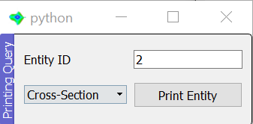
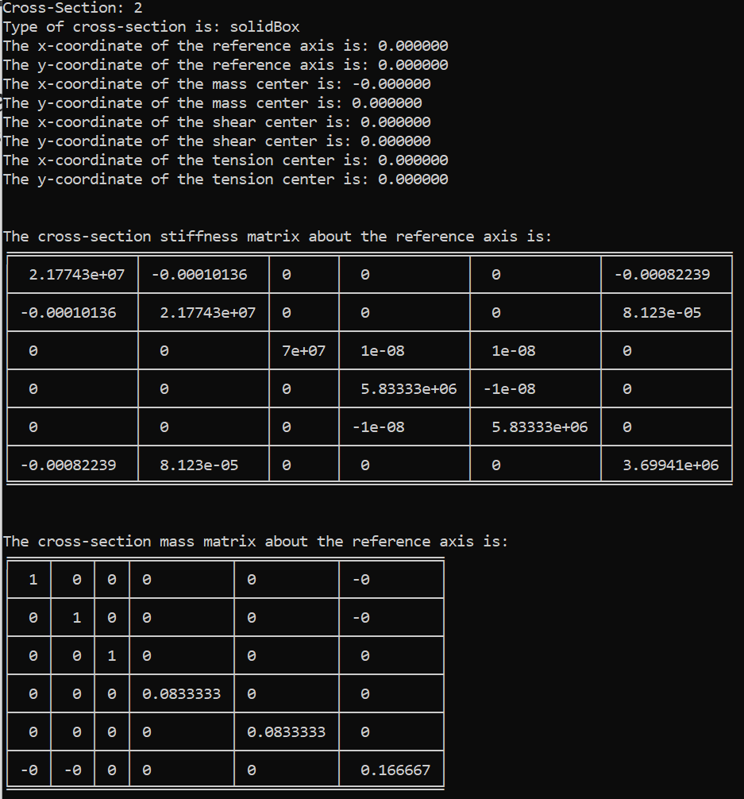
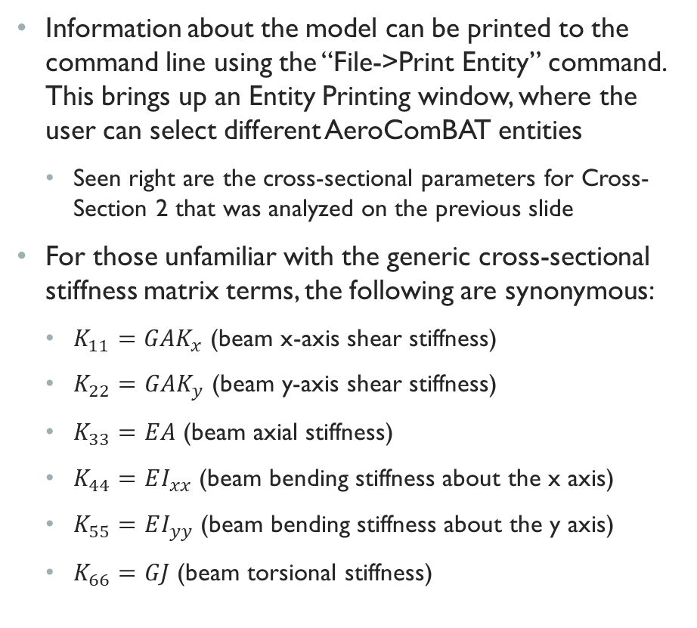
2.3.4 – AeroComBAT cross-sectional Analysis
Application
Information about the model can be printed to the command line using the “File->Print Entity” command. This brings up an Entity Printing window, where the user can select different AeroComBAT entities
Seen right are the cross-sectional parameters for Cross-Section 2 that was analyzed on the previous slide
For those unfamiliar with the generic cross-sectional stiffness matrix terms, the following are synonymous:
$K_{11}=GAK_{x}$ (beam x-axis shear stiffness)
$K_{22}=GAK_{y}$ (beam y-axis shear stiffness)
$K_{33}=EA$ (beam axial stiffness)
$K_{44}=EI_{xx}$ (beam bending stiffness about the x axis)
$K_{55}=EI_{yy}$ (beam bending stiffness about the y axis)
$K_{66}=GJ$ (beam torsional stiffness)

Slide 20
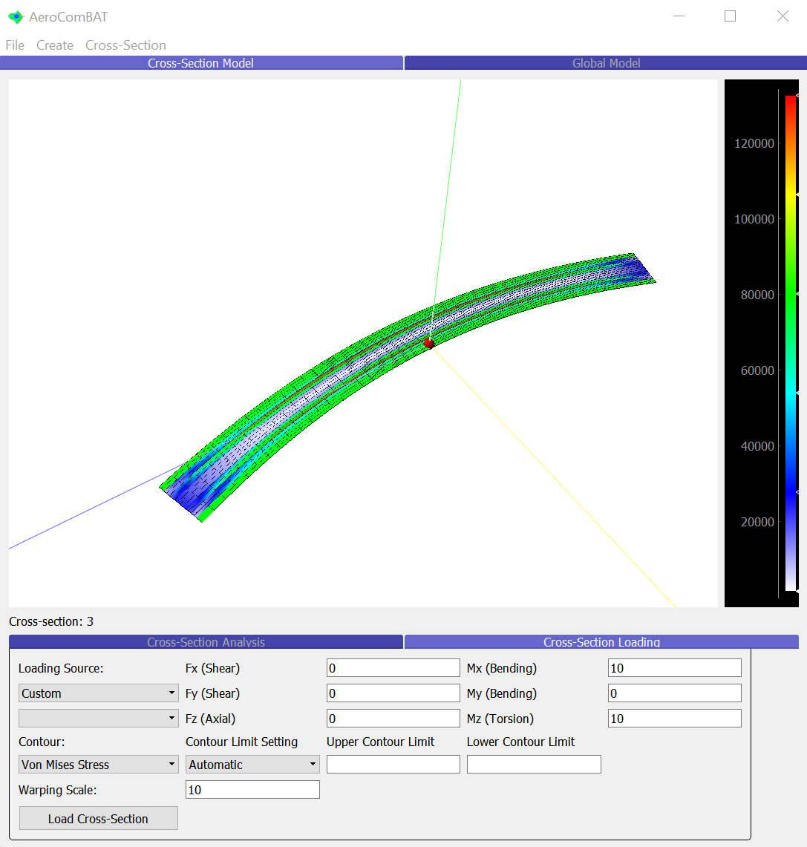
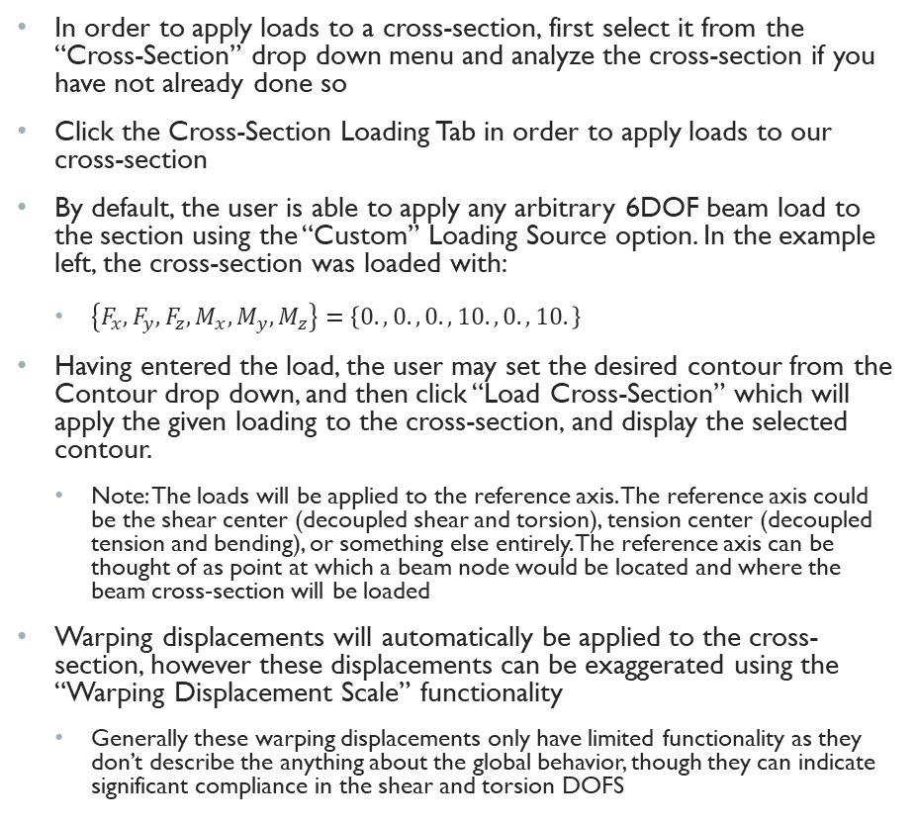
2.3.5 – AeroComBAT cross-sectional Analysis
Application
In order to apply loads to a cross-section, first select it from the “Cross-Section” drop down menu and analyze the cross-section if you have not already done so
Click the Cross-Section Loading Tab in order to apply loads to our cross-section
By default, the user is able to apply any arbitrary 6DOF beam load to the section using the “Custom” Loading Source option. In the example left, the cross-section was loaded with:
$\left\{F_{x},F_{y},F_{z},M_{x},M_{y},M_{z}\right\}=\left\{0.,0.,0.,10.,0.,10.\right\}$
Having entered the load, the user may set the desired contour from the Contour drop down, and then click “Load Cross-Section” which will apply the given loading to the cross-section, and display the selected contour.
Note: The loads will be applied to the reference axis. The reference axis could be the shear center (decoupled shear and torsion), tension center (decoupled tension and bending), or something else entirely. The reference axis can be thought of as point at which a beam node would be located and where the beam cross-section will be loaded
Warping displacements will automatically be applied to the cross-section, however these displacements can be exaggerated using the “Warping Displacement Scale” functionality
Generally these warping displacements only have limited functionality as they don’t describe the anything about the global behavior, though they can indicate significant compliance in the shear and torsion DOFS

Slide 21
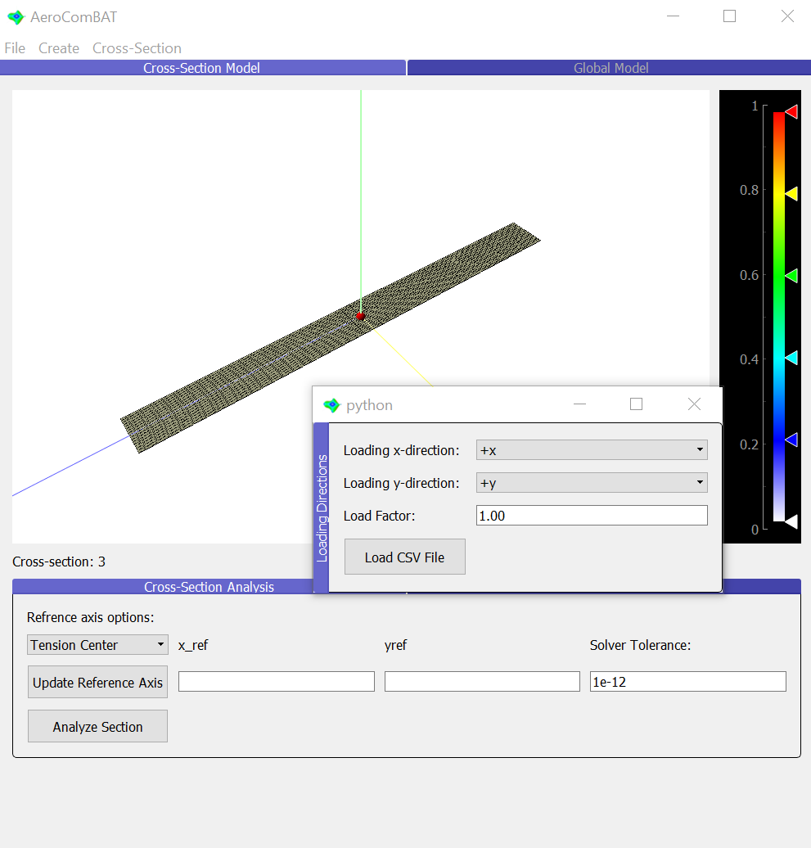
2.3.6 – AeroComBAT cross-sectional Analysis
Application
Should you want to apply multiple loads to a cross-section, one can import multiple load cases using the “File->Load CSV Loads File” functionality
Note: When analyzing sections (including applying loads to a section), we are limited to the x-y plane for where loads can be applied. As such, if your cross-section mesh lies in a different plane, you’ll need to tell AeroComBAT what global CSYS your loads correspond to. For example, if a user’s mesh lies in the y-z plane, then +y global CSYS corresponds to the +x AeroComBAT CSYS, and the +z global CSYS corresponds to the +y AeroComBAT CSYS. Possible entries include: “+x”, “-x”, “+y”, “-y”, “+z”, “-z”
For this demo, we’ll maintain that +x Global corresponds to +x AeroComBAT, etc…
Section | LCID | x | y | z | Fx | Fy | Fz | Mx | My | Mz
2 | 1 | 0 | 0 | 0 | 1 | 1 | 1 | 2 | 2 | 2
2 | 2 | 1 | 0 | 0 | 1 | 1 | 1 | 2 | 2 | 2
2 | 3 | 0 | 1 | 0 | 1 | 1 | 1 | 2 | 2 | 2
2 | 4 | 0 | 1 | 0 | 10 | 0 | 0 | 0 | 0 | 0

Slide 22
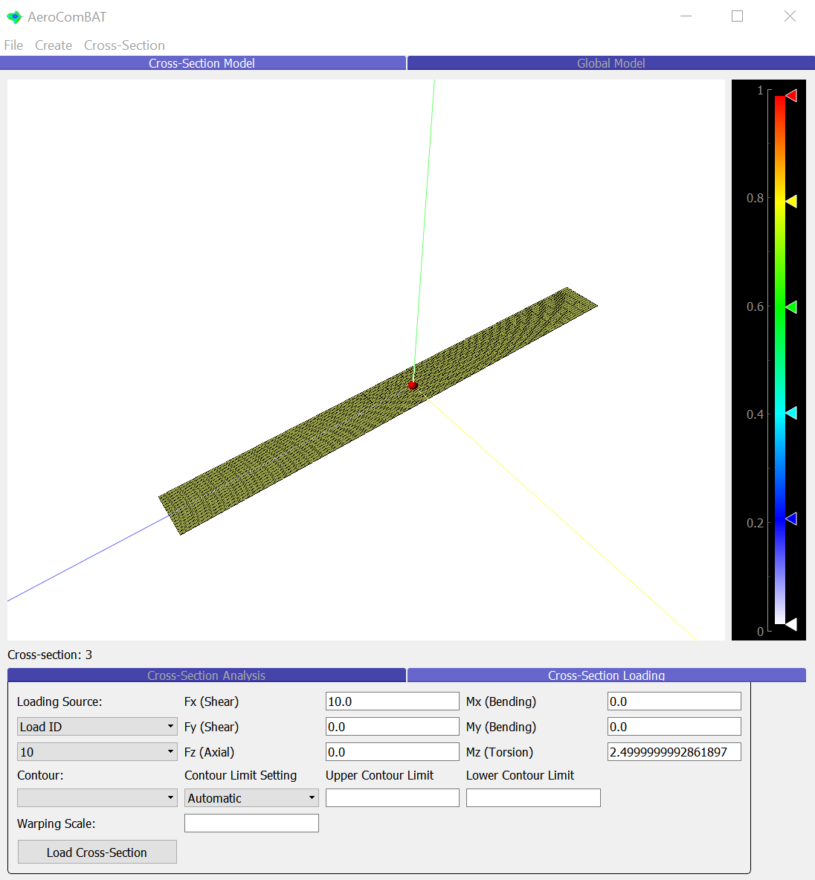
2.3.7 – AeroComBAT cross-sectional Analysis
Application
When importing loads, the user now has access to three additional load sources: “All”, “Set”, and “Load ID”
“All”: Will load your cross-section with all loads that have been added to the section
“Set”: All imported loads that come from the same .csv file will share a set ID. This option will then load the section with all loads associated with the chosen Set ID
“Load ID”: All load IDs that have been added to a section will be added to the additional load drop down. When an individual load is selected, from the drop down, it will populate the load fields, all automatically transformed to the reference axis of the cross-section
The user can then select a contour, and click the “Load Cross-Section” button for results.
Note: When choosing the “All” or “Set” options which will load the cross-section with multiple load cases, the Max Abs envelope of the selected contour will be shown for each element. However, individual load cases can always be selected and investigated using the “Load ID” option.

Slide 23
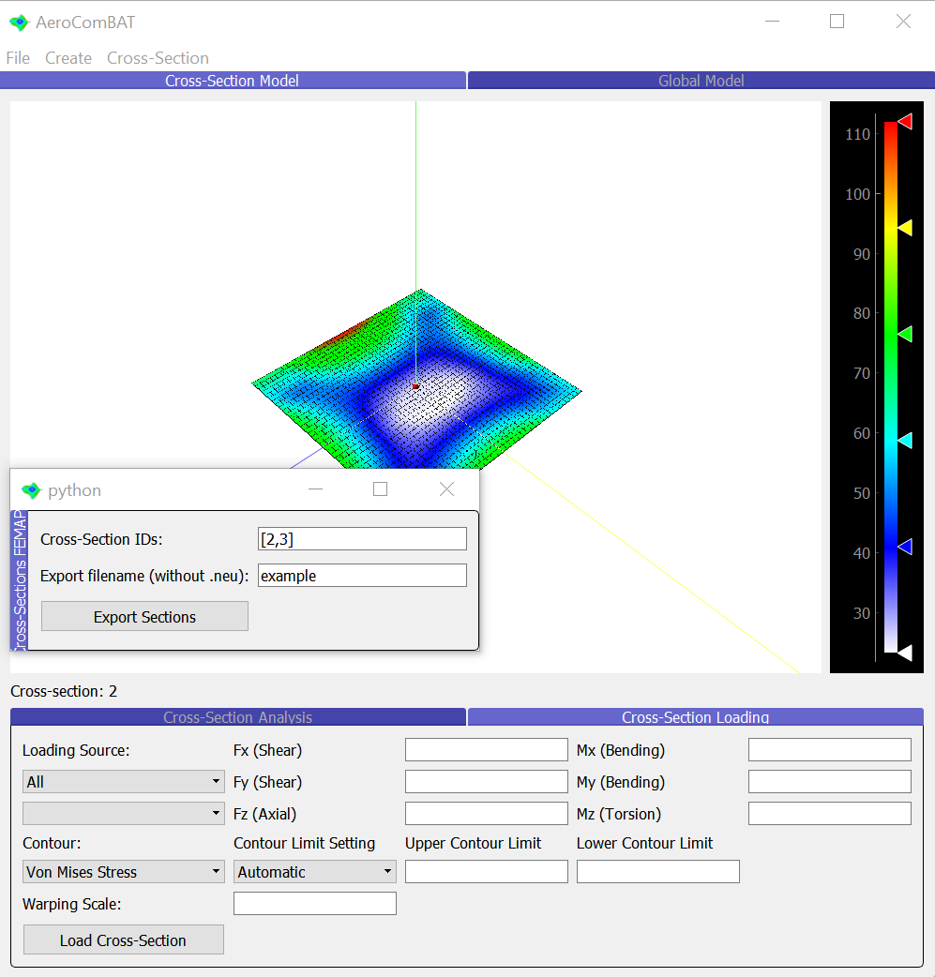
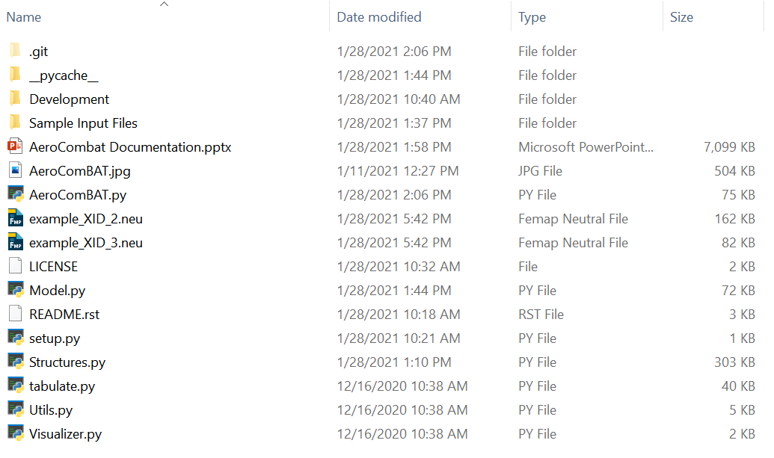
2.3.8 – AeroComBAT cross-sectional Analysis
Application
Once a cross-section has been imported into AeroComBAT, the user also has the option to export cross-section meshes to FEMAP for later post processing. This can be done using the “Cross-Section -> Export Section FEMAP Neutral” command
This will create a pop up where the cross-section IDs (XIDs 2 and 3) for export are requested, and a file prefix (“example”). This will make two new files in the root AeroComBAT directory:

Slide 24


2.3.10 – AeroComBAT cross-sectional Analysis
Application
Once a cross-section has been analyzed and loads have been applied, the contours can be exported as a FEMAP neutral file as well using the “Cross-Sections -> Export Sections Criteria” command
When selected, the Cross-Section Results pop-up will appear, giving the user the ability to export several different contours. The user will enter the cross-section IDs, filename prefix, and select all the criteria to be exported to the neutral file.
In the right example, several stress components have been selected for export for cross-section 2, and the export will have the prefix “export_example”

Slide 25
3.0 – AeroComBAT Future Development
Future Development
Further develop reading or translating NASTRAN decks
Facilitate outputting NASTRAN dat files to tapered beam elements using cross-sectional meshes
Further develop exporting contour data for post-processing, such as in csv format
Support visualizing beam elements using tapered sections

Slide 26


3.1 – AeroComBAT Future Development
While not yet officially supported, there is a script in the Development directory called “beam_generator.py” which can be used to quickly generate a NASTRAN bulk data file containing a series tapered beam elements
To generate a beam element, the user may point the script to in input csv file in line 8, which takes the form seen below in the table
Note: This table exists in the “Sample Input Files” directory as “sample_beam_model.csv”
To successfully export a dat file, the user must also point the script to an output file for the dat file
This could simply be a filename “output.dat” at which point, the output file “output.dat” would appear in the development directory
NOTE: Currently this script is only valid for beams running in the x-direction, and is not ready for “plug-and-play” use
x | y | z | EA (lb) | EI_yy (lb-in^2) | EI_zz (lb-in^2) | EI_yz (lb-in^2) | GJ (lb-in^2) | Gak_y | Gak_z | A [in^2]
1 | 0 | 0.1 | 1 | 2.01 | 4.02 | 0 | 2 | 0.833333 | 0.833333 | 0.5
2 | 0 | 0.1 | 2 | 4.02 | 8.04 | 0 | 4 | 1.666667 | 1.666667 | 1
3 | 0 | 0.3 | 3 | 6.27 | 12.54 | 0 | 6 | 2.5 | 2.5 | 1.5
4 | 0 | 0.2 | 4 | 8.16 | 16.32 | 0 | 8 | 3.333333 | 3.333333 | 2
5 | 0 | 0.1 | 5 | 10.05 | 20.1 | 0 | 10 | 4.166667 | 4.166667 | 2.5

Slide 27
4.1.0 – AeroComBAT Card Reference Guide
The following slides will be dedicated to establishing input form for the cards that AeroComBAT supports
Note, all cards are listed in a single line where fields are separated by commas

Slide 28
4.1.1 – AeroComBAT Card Reference Guide
Application
Card: XNODE
This card represents a cross-section node to be used for cross-sectional analysis
Form:
XNODE,NID,X,Y
NID (int): The node identifier
X (float): The node x-coordinate
Y (float): The node y-coordinate

Slide 29
4.1.2 – AeroComBAT Card Reference Guide
Application
Card: MAT_ISO
This card represents an isotropic material (such as a metal or plastic).
Form 1:
MAT_ISO,MID,name,E,nu,rho
Form 2:
MAT_ISO,MID,name,E,nu,rho,mat_t
Form 3:
MAT_ISO,MID,name,E,nu,rho,mat_t,Xt,Xc,Sxy
MID (int): The material identifier
Name (str): The material name
E (float): The material young’s modulus
nu (float): The material Poisson ratio
rho (float): The material mass density
mat_t (float): If the material is used to define laminates, this thickness sets ply thicknesses
Xt (float): The ultimate tensile strength of the material
Xc (float): The ultimate compressive strength of the material
Sxy (float): The ultimate shear strength of the material

Slide 30
4.1.3 – AeroComBAT Card Reference Guide
Application
Card: MAT_TISO
This card represents a transversely isotropic material (such as unidirectional tape).
Form 1:
MAT_TISO,MID,name,E1,E2,nu23,nu12,G12,rho
Form 2:
MAT_TISO,MID,name,E1,E2,nu23,nu12,G12,rho,mat_t
Form 3:
MAT_TISO,MID,name,E1,E2,nu23,nu12,G12,rho,mat_t,Xt,Xc,Yt,Yc,Sxy
MID (int): The material identifier
Name (str): The material name
E1 (float): The material bulk stiffness in the 1 direction
E2 (float): The material bulk stiffness in the 2 direction
nu23 (float): The material Poisson ratio in the 23 direction
nu12 (float): The material Poisson ratio in the 12 direction
G12 (float): The material shear modulus in the 12 direction
rho (float): The material mass density
mat_t (float): If the material is used to define laminates, this thickness sets ply thicknesses
Xt (float): The ultimate tensile strength of the material in the 1 direction
Xc (float): The ultimate compressive strength of the material in the 1 direction
Yt (float): The ultimate tensile strength of the material in the 2 direction
Yc (float): The ultimate compressive strength of the material in the 2 direction
Sxy (float): The ultimate shear strength of the material

Slide 31
4.1.4 – AeroComBAT Card Reference Guide
Application
Card: MAT_ORTHO
This card represents am orthotropic material (such as some cores and bi-directional fabrics).
Form 1:
MAT_ORTHO,MID,name,E1,E2,E3,nu23,nu13,nu12,G23,G13,G12,rho
Form 2:
MAT_ORTHO,MID,name,E1,E2,E3,nu23,nu13,nu12,G23,G13,G12,rho,mat_t
Form 3:
MAT_ORTHO,MID,name,E1,E2,E3,nu23,nu13,nu12,G23,G13,G12,rho,mat_t,Xt,Xc,Yt,Yc,Zt,Zc,Syz,Sxz,Sxy
MID (int): The material identifier
Name (str): The material name
E1 (float): The material bulk stiffness in the 1 direction
E2 (float): The material bulk stiffness in the 2 direction
E3 (float): The material bulk stiffness in the 3 direction
nu23 (float): The material Poisson ratio in the 23 direction
nu13 (float): The material Poisson ratio in the 23 direction
nu12 (float): The material Poisson ratio in the 12 direction
G23 (float): The material shear modulus in the 23 direction
G13 (float): The material shear modulus in the 13 direction
G12 (float): The material shear modulus in the 12 direction
rho (float): The material mass density
mat_t (float): If the material is used to define laminates, this thickness sets ply thicknesses
Xt (float): The ultimate tensile strength of the material in the 1 direction
Xc (float): The ultimate compressive strength of the material in the 1 direction
Yt (float): The ultimate tensile strength of the material in the 2 direction
Yc (float): The ultimate compressive strength of the material in the 2 direction
Zt (float): The ultimate tensile strength of the material in the 3 direction
Zc (float): The ultimate compressive strength of the material in the 3 direction
Syz (float): The ultimate shear strength of the material
Sxz (float): The ultimate shear strength of the material
Sxy (float): The ultimate shear strength of the material

Slide 32
4.1.5 – AeroComBAT Card Reference Guide
Application
Card: XQUAD4
This card represents a linear, 4 noded quad element.
Form 1:
XQUAD4,EID,NID1,NID2,NID3,NID4,MID
Form 2:
XQUAD4,EID,NID1,NID2,NID3,NID4,MID,th1,th2,th3
EID (int): The element identifier
MID (int): The material identifier
NIDn (int): The nth node ID referenced by the element
thn (float): The nth euler angle to define the local element material CSYS
N4
N3
N1
N2

Slide 33
4.1.5 – AeroComBAT Card Reference Guide
Application
Card: XQUAD6
This card represents mixed linear-quadratic 6 noded quad element. This element could be used to model stress over a ply where the strain gradient changes quickly along the length, but slowly over the width.
Form 1:
XQUAD6,EID,NID1,NID2,NID3,NID4,NID5,NID6,MID
Form 2:
XQUAD6,EID,NID1,NID2,NID3,NID4,NID5,NID6,MID,th1,th2,th3
EID (int): The element identifier
MID (int): The material identifier
NIDn (int): The nth node ID referenced by the element
thn (float): The nth euler angle to define the local element material CSYS
N6
N5
N4
N1
N2
N3

Slide 34
4.1.6 – AeroComBAT Card Reference Guide
Application
Card: XQUAD8
This card represents quadratic, 8 noded quad element.
Form 1:
XQUAD8,EID,NID1,NID2,NID3,NID4,NID5,NID6,NID7,NID8,MID
Form 2:
XQUAD8,EID,NID1,NID2,NID3,NID4,NID5,NID6,NID7,NID8,MID,th1,th2,th3
EID (int): The element identifier
MID (int): The material identifier
NIDn (int): The nth node ID referenced by the element
thn (float): The nth euler angle to define the local element material CSYS
N7
N6
N5
N8
N4
N1
N2
N3

Slide 35
4.1.7 – AeroComBAT Card Reference Guide
Application
Card: XQUAD9
This card represents quadratic, 9 noded quad element. The fidelity should be similar to that of the 8 noded serendipity element
Form 1:
XQUAD9,EID,NID1,NID2,NID3,NID4,NID5,NID6,NID7,NID8,NID9,MID
Form 2:
XQUAD9,EID,NID1,NID2,NID3,NID4,NID5,NID6,NID7,NID8,NID9,MID,th1,th2,th3
EID (int): The element identifier
MID (int): The material identifier
NIDn (int): The nth node ID referenced by the element
thn (float): The nth euler angle to define the local element material CSYS
N7
N8
N9
N5
N4
N6
N1
N2
N3

Slide 36
4.1.8 – AeroComBAT Card Reference Guide
Application
Card: XTRIA3
This card represents linear, 3 noded tri element. Note that this is a constant strain element and should be used sparingly.
Form 1:
XTRIA3,EID,NID1,NID2,NID3,MID
Form 2:
XTRIA3,EID,NID1,NID2,NID3,MID,th1,th2,th3
EID (int): The element identifier
MID (int): The material identifier
NIDn (int): The nth node ID referenced by the element
thn (float): The nth euler angle to define the local element material CSYS
N2
N3
N1

Slide 37
4.1.9 – AeroComBAT Card Reference Guide
Application
Card: XTRIA6
This card represents quadratic, 6 noded tri element.
Form 1:
XTRIA6,EID,NID1,NID2,NID3,NID4,NID5,NID6,MID
Form 2:
XTRIA6,EID,NID1,NID2,NID3,NID4,NID5,NID6,MID,th1,th2,th3
EID (int): The element identifier
MID (int): The material identifier
NIDn (int): The nth node ID referenced by the element
thn (float): The nth euler angle to define the local element material CSYS
N2
N4
N5
N3
N6
N1

Slide 38
4.1.10 – AeroComBAT Card Reference Guide
Application
Card: LIST
This card represents a list.
Form 1:
LIST,LSID,DTYPE,Xn
LSID (int): The list identifier
DTYPE (str): Determines if the list contains integers (“INT”) or floats (“FLOAT”)
Xn (int): The nth number in the list.

Slide 39
4.1.11 – AeroComBAT Card Reference Guide
Application
Card: LAMINATE
This card represents a laminate.
Form 1:
LAMINATE,LAMID,N_i LSID,M_i LSID,TH_i LSID,SYM
Example:
LIST,1,INT,1,1,1,1
LIST,2,INT,2,2,2,2
LIST,3,FLOAT,0,45,-45,90
LAMINATE,1,1,2,3,TRUE
This corresponds to a laminate which has 1 ply per orientation, each orientation uses MID 2, and the layup schedule is:
[0/45/-45/90]_s
LAMID (int): The laminate identifier
N_i LSID(int): The list ID corresponding to a list where each entry corresponds to the number of plies at a given orientation
M_i LSID(int): The list ID corresponding to a list where each entry corresponds to the material ID of plies at a given orientation
TH_i LSID(int): The list ID corresponding to a list where each entry corresponds to the orientation of plies at a given orientation
SYM (BOOL): Either “TRUE” or “FALSE”, this determines of a laminate should be mirrored or not

Slide 40
4.1.12 – AeroComBAT Card Reference Guide
Application
Card: SECTIONSB
This card represents a solid rectangular cross-section.
Form 1:
SECTIONSB,XID,MID,L1,L2,ELEMTYPE,ELEMX,ELEMY
XID (int): The cross-section identifier
MID(int): The material ID for the material used by the cross-section
L1 (float): The dimension of the cross-section, L1
L2 (float): The dimension of the cross-section, L2
ELEMTYPE (str): The list of selectable element types. Options are: “XQUAD4”, “XQUAD6”, “XQUAD8”, “XQUAD9”
ELEMX (int): The number of elements running in the L1 direction
ELEMY (int): The number of elements running in the L2 direction
L2
L1

Slide 41
4.1.13 – AeroComBAT Card Reference Guide
Application
Card: SECTIONLM
This card represents a laminate coupon cross-section.
Form 1:
SECTIONLM,XID,LAMID,L1,ELEMTYPE,ELEMAR
XID (int): The cross-section identifier
LAMID (int): The laminate ID used by the cross-section
L1 (float): The dimension of the cross-section, L1
ELEMTYPE (str): The list of selectable element types. Options are: “XQUAD4”, “XQUAD6”, “XQUAD8”, “XQUAD9”
ELEMAR (int): Specifies the maximum aspect ratio of any element
NOTE: When meshing this type of cross-section, only 1 element is used through the thickness of each ply. The width of the elements (in the L1 direction) are set by the ELEMAR such that no ply contains an element with an aspect ratio larger than ELEMAR
L1

Slide 42
4.1.14 – AeroComBAT Card Reference Guide
Application
Card: SECTIONCT
This card represents a composite tube cross-section which uses N laminates which divide the composite tube evenly
Form 1:
SECTIONCT,XID,LSID,R,ELEMTYPE,ELEMAR
XID (int): The cross-section identifier
LSID (int): Corresponds to a list ID which holds a list of laminate IDs to be used by the cross-section.
R (float): The inner radius of the composite tube
ELEMTYPE (str): The list of selectable element types. Options are: “XQUAD4”, “XQUAD6”, “XQUAD8”, “XQUAD9”
ELEMAR (int): Specifies the maximum aspect ratio of any element
NOTE: When meshing this type of cross-section, only 1 element is used through the thickness of each ply. The width of the elements (in the theta direction) are set by the ELEMAR such that no ply contains an element with an aspect ratio larger than ELEMAR
NOTE: All laminate thicknesses from the bottom-most ply must be equal such that no ply of one laminate ends in the middle of another ply in another laminate. However, not all laminates must have the same number of plies.
R

Slide 43
4.1.15 – AeroComBAT Card Reference Guide
Application
Card: SECTIONCC
This card represents c-channel cross-section that uses a constant laminate
Form 1:
SECTIONCC,XID,LAMID,L1,L2,ELEMTYPE,ELEMAR
XID (int): The cross-section identifier
LAMID (int): The laminate ID used by the cross-section
L1 (float): The dimension of the cross-section, L1
L2 (float): The dimension of the cross-section, L1
ELEMTYPE (str): The list of selectable element types. Options are: “XQUAD4”, “XQUAD6”, “XQUAD8”, “XQUAD9”
ELEMAR (int): Specifies the maximum aspect ratio of any element
NOTE: When meshing this type of cross-section, only 1 element is used through the thickness of each ply. The width of the elements (in the L1 or L2 direction) are set by the ELEMAR such that no ply contains an element with an aspect ratio larger than ELEMAR
L2
L1

Slide 44
4.1.16 – AeroComBAT Card Reference Guide
Application
Card: SECTIONG
This card represents a general cross-section.
Form 1:
SECTIONG,XID,LSID
XID (int): The cross-section identifier
LSID (int): Corresponds to a list ID which holds a list of all elements used by the cross-section.
NOTE: The most generic cross-section, this relies on the meshing to occur outside of AeroComBAT.

